Slide 1
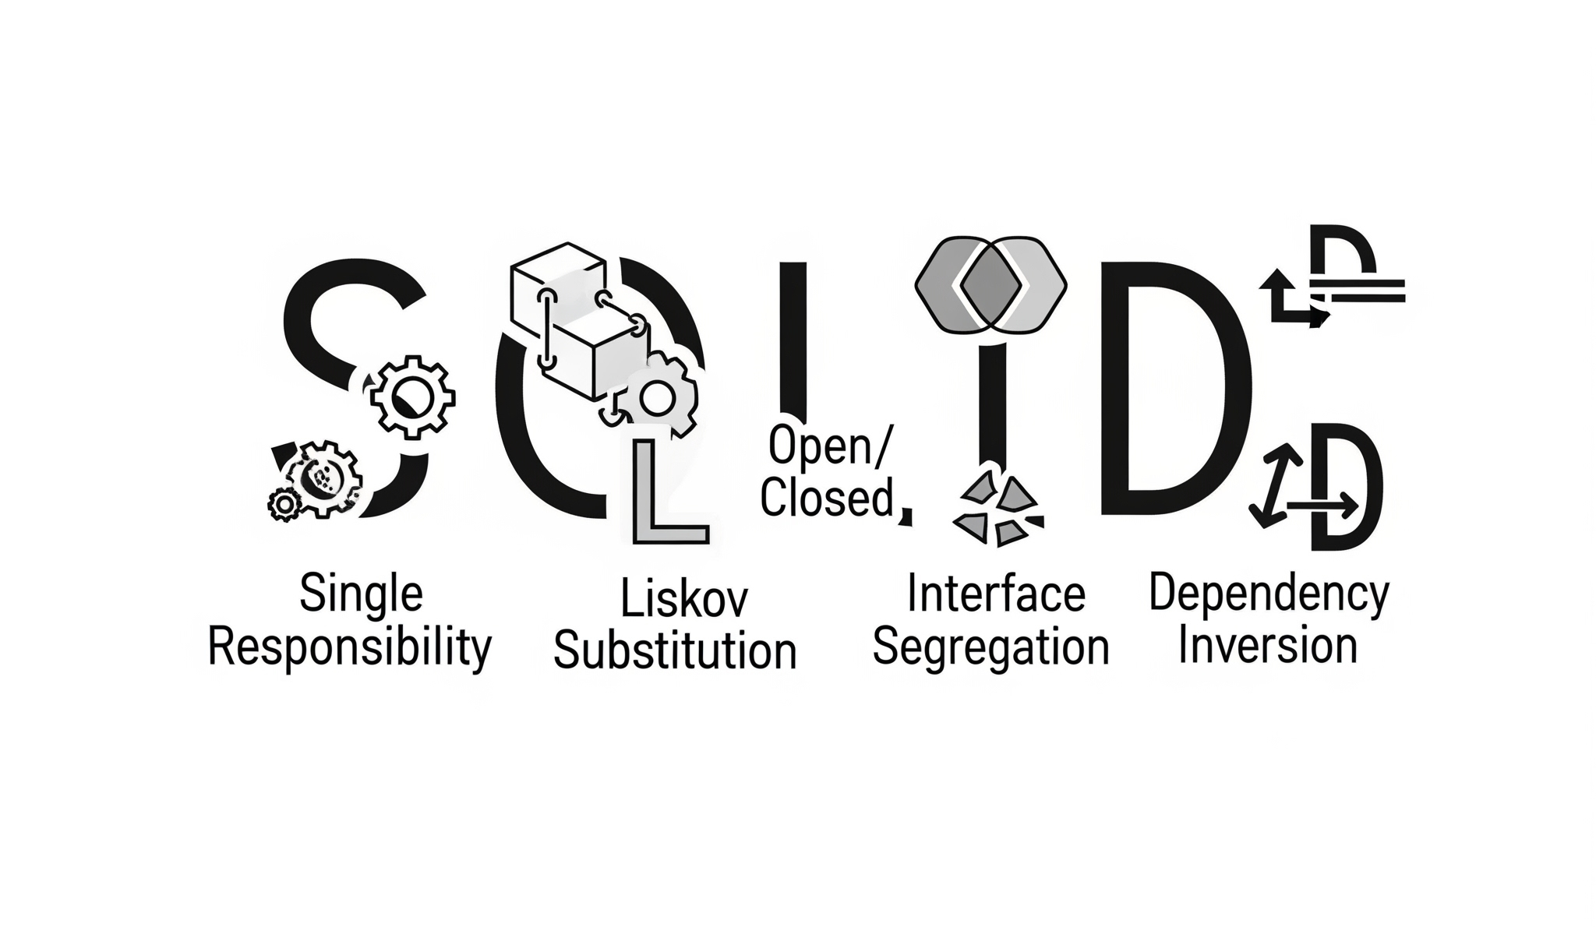
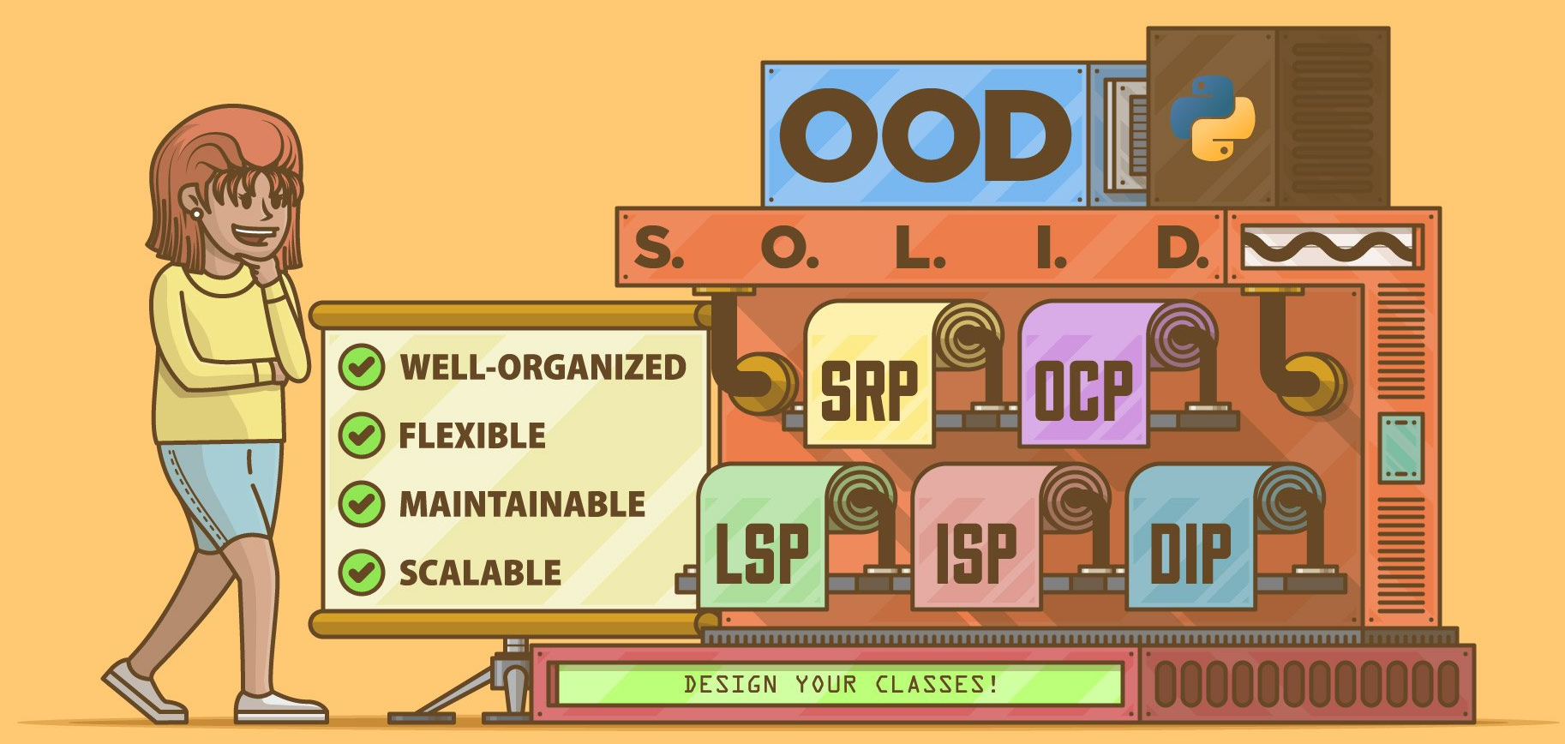
What is SOLID Principles?
The SOLID principles are a set of five key object-oriented design principles that help developers build software that is easy to maintain, scale, test, and refactor. These principles were popularized by Robert C. Martin (Uncle Bob) and are considered fundamental for good software architecture, especially in Object-Oriented Programming (OOP).

Slide 2
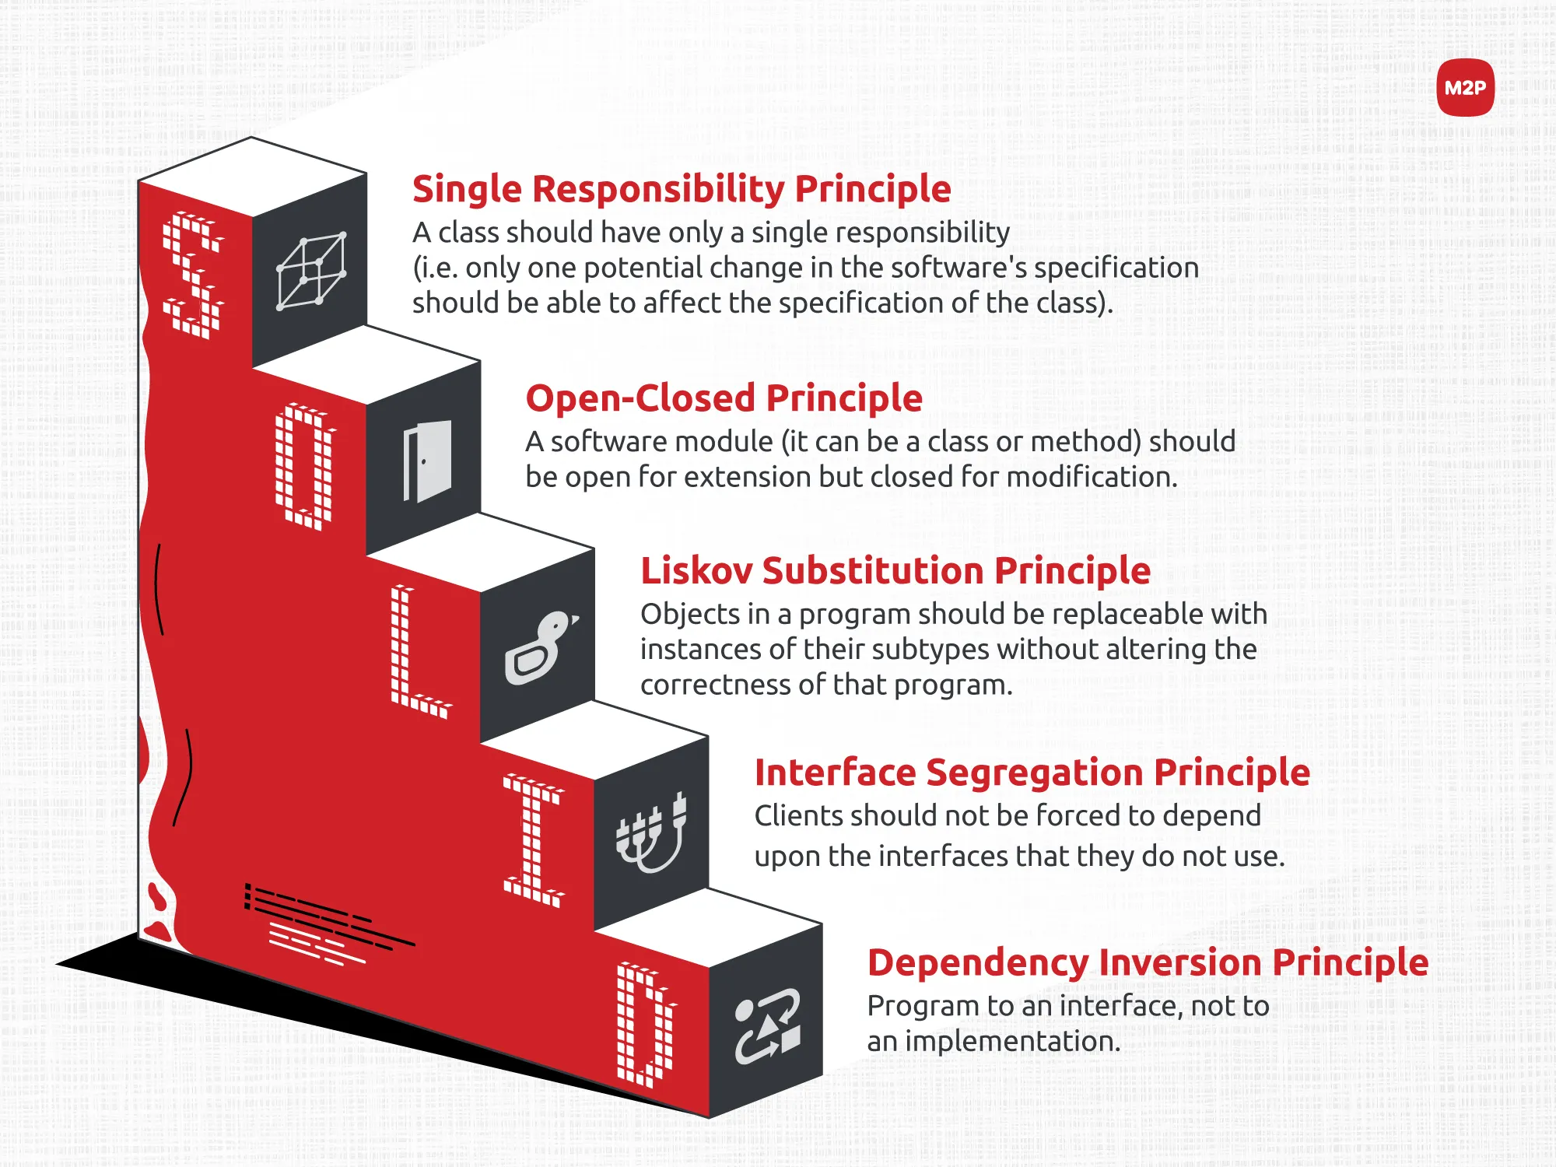
4 Fundamental Pillars of OOPs?

Slide 3
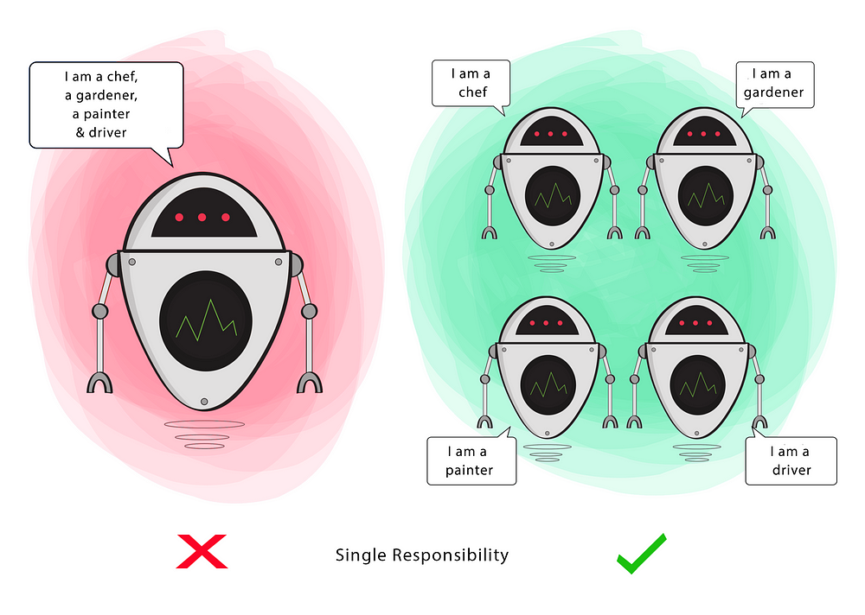
SOLID S - Single Responsibility Principle (SRP)
A class should have a single responsibility.
If a Class has many responsibilities, it increases the possibility of bugs because making changes to one of its responsibilities, could affect the other ones without you knowing.
Goal
This principle aims to separate behaviors so that if bugs arise as a result of your change, it won’t affect other unrelated behaviors.

Slide 4
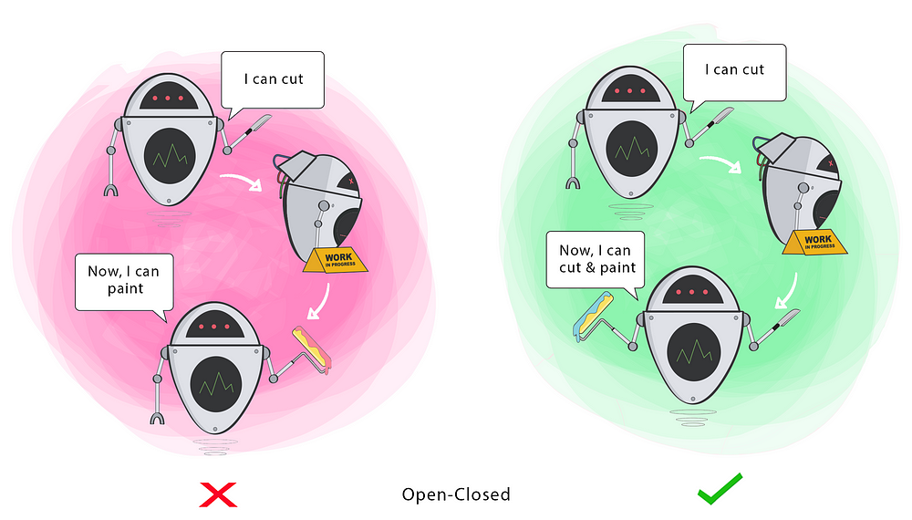
SOLID O - Open/Closed Principle (OCP)
Classes should be open for extension, but closed for modification.
Changing the current behavior of a Class will affect all the systems using that, Class.
If you want the Class to perform more functions, the ideal approach is to add to the functions that already exist NOT change them.
Goal
This principle aims to extend a Class’s behavior without changing the existing behavior of that Class. This is to avoid causing bugs wherever the Class is being used.

Slide 5
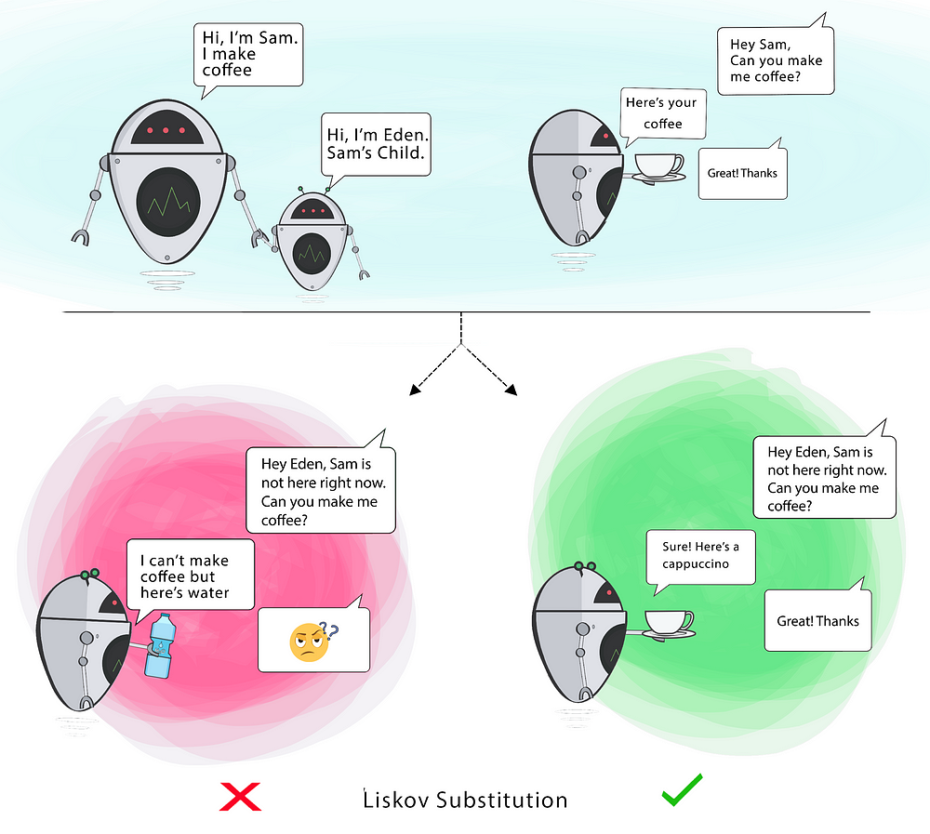
SOLID L - Liskov Substitution Principle (LSP)
Objects of a superclass should be replaceable with objects of its subclasses without affecting the correctness of the program.
Goal
This principle aims to enforce consistency so that the parent Class or its child Class can be used in the same way without any errors.

Slide 6
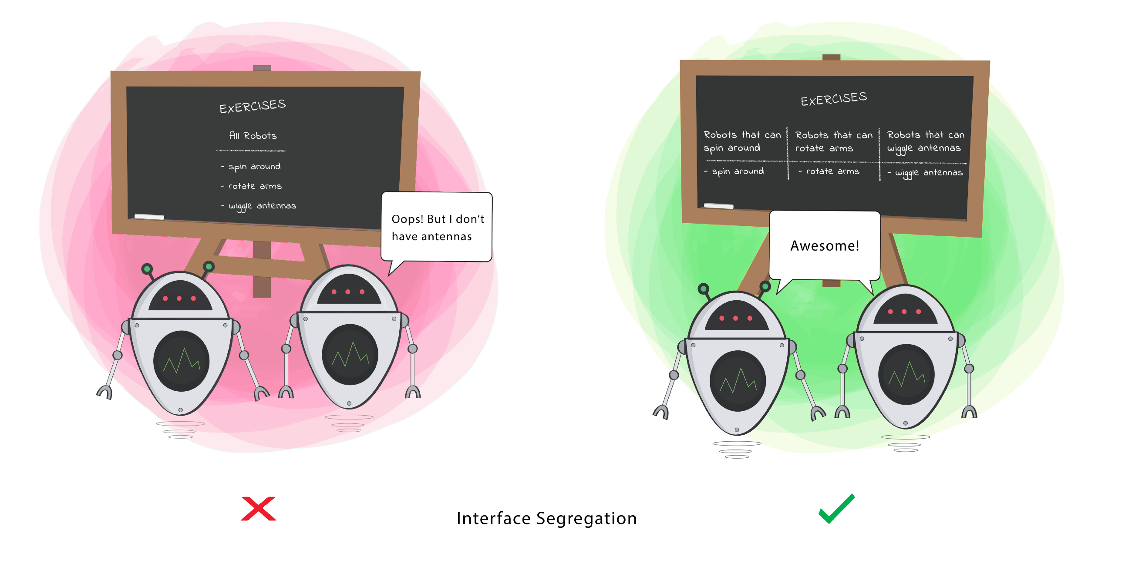


SOLID I – Interface Segregation Principle (ISP)
Clients should not be forced to depend on methods that they do not use.
Goal
This principle aims at splitting a set of actions into smaller sets so that a Class executes ONLY the set of actions it requires.

Slide 7
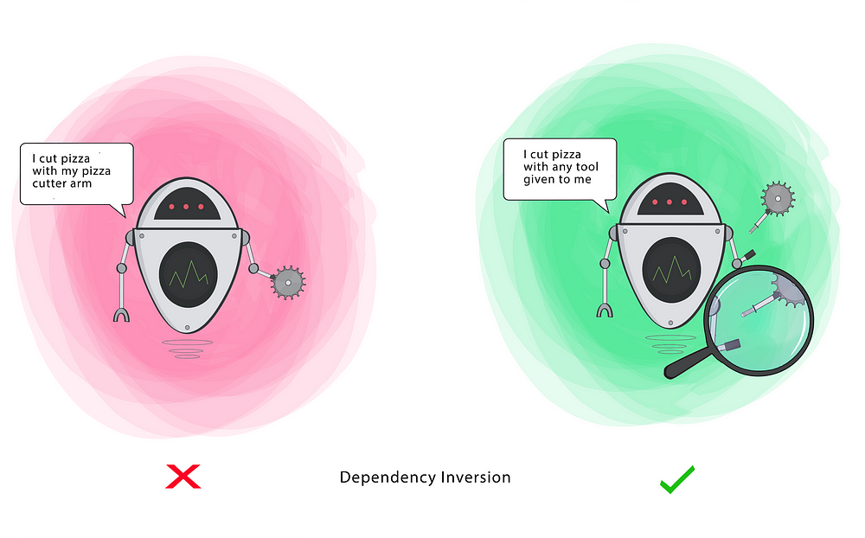
SOLID D – Dependency Inversion Principle (DIP)
High-level modules should not depend on low-level modules. Both should depend on the abstraction.
Abstractions should not depend on details. Details should depend on abstractions.
Goal
This principle aims at reducing the dependency of a high-level Class on the low-level Class by introducing an interface.

